Slide 1
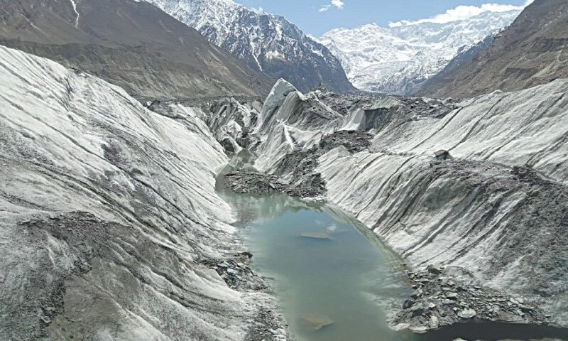
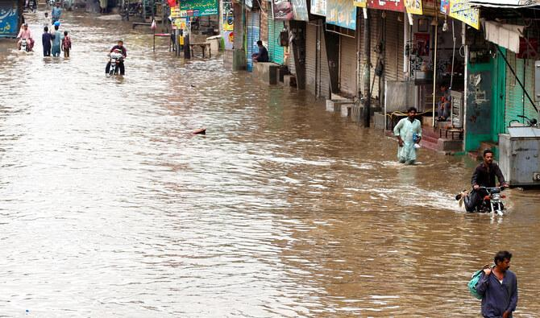
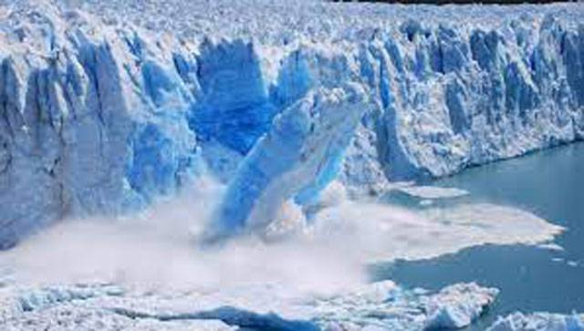
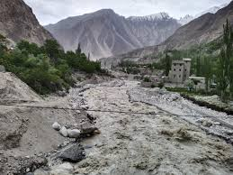
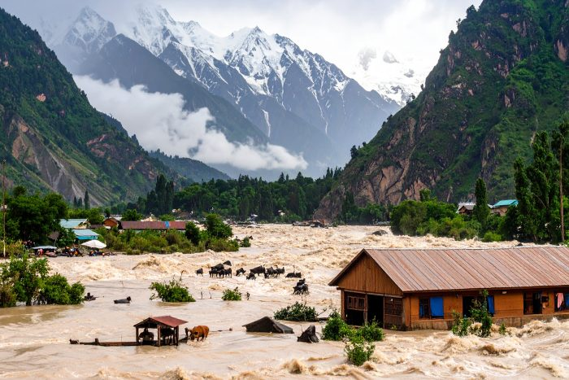
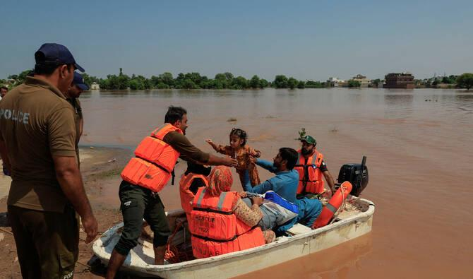
Sustainable Resilience Plan – Pakistan

Slide 2
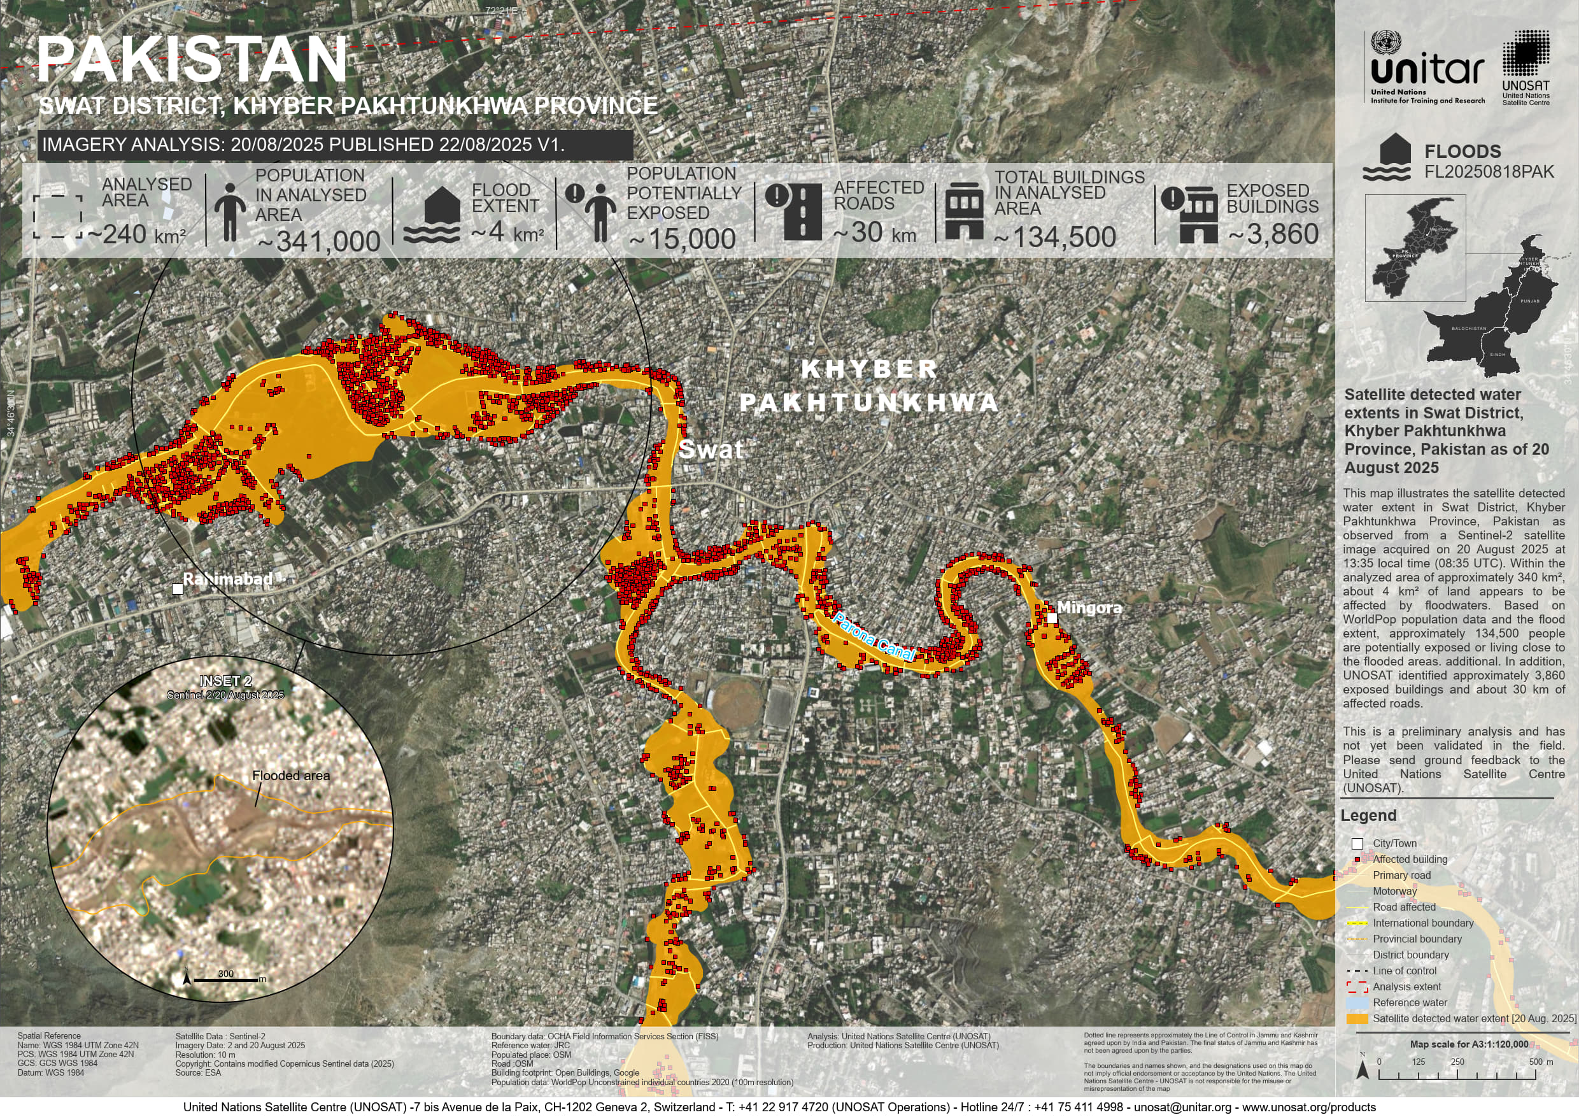
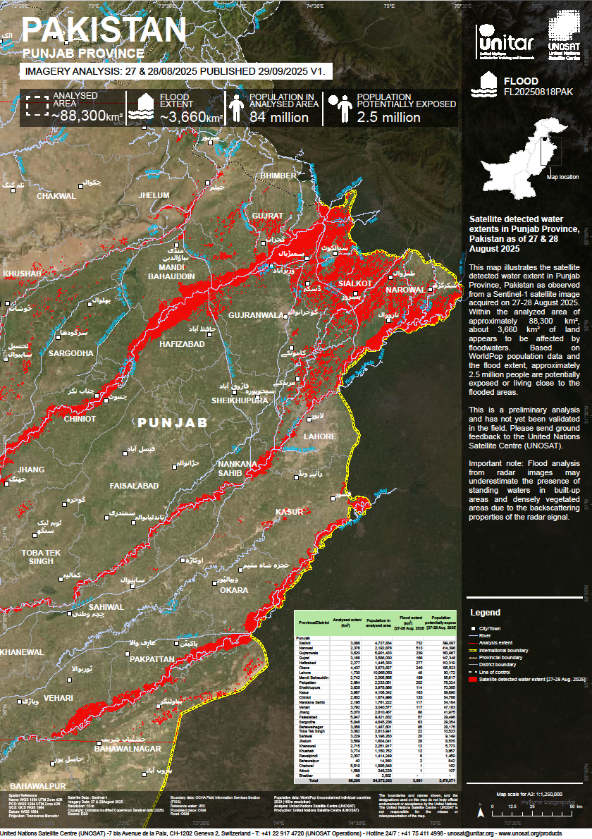

Slide 3
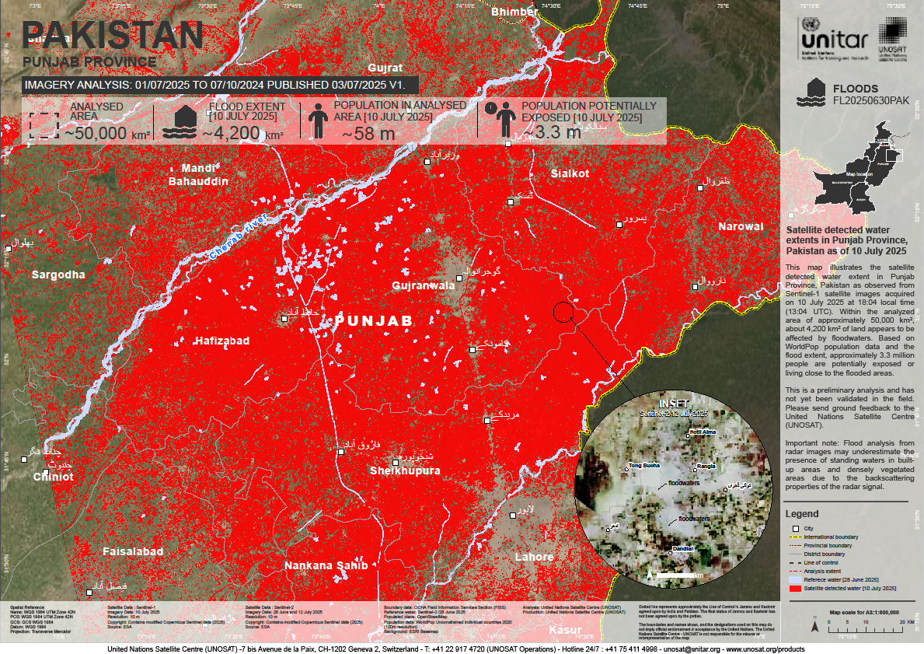

Slide 4
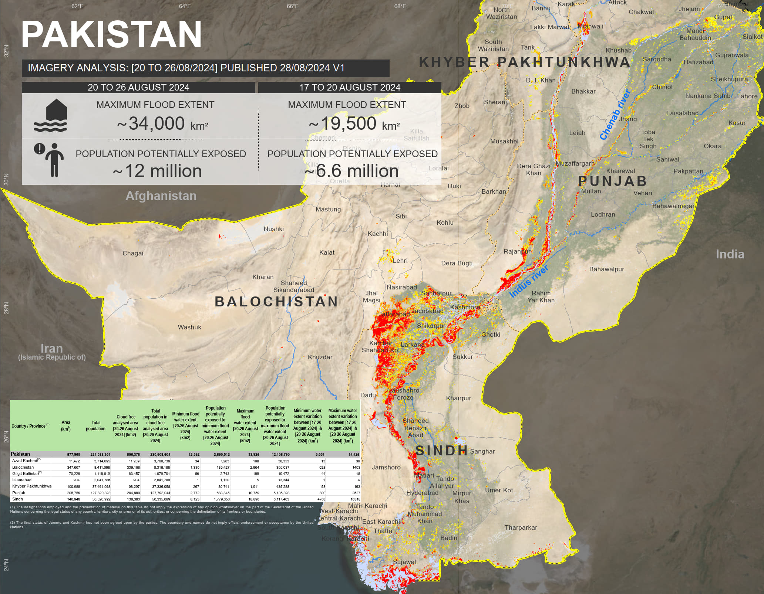

Slide 5
Distt | c | Feb | Mar | Apr | May | Jun | Jul | Aug | Sep | Oct | Nov | Dec
Attock
Rwp
Chakwal
Jhelum
M. B Din
Sargodha
Gujrat
Mianwali
Bhakkar
Layyah
Jhang
Hfzabad
Gwa
Chiniot
Sialkot
Narowal
Toba TS
Fsb
N.Sahib
Sh.pura
Lahore
Kasur
Okara
Sahiwal
Kh.wal
P.Patan
Vehari
DG K
Mzfgh
Rajan.p
RYK
Multan
Lodhran
Bwn
Bwp
Khushab
Fog, Travel Hz
6.0
Heatwave
4.5
Flood
5.3
Fog
6.3
Cold Waves / Fog
6.9
Heatwave
6.9
Flood/Inund/LS
6.3
Smog/Fog
7.9
Fog
5.9
Heatwave
5.8
Inund
4.5
Smog/Fog
6.5
Fog
7.0
Heatwave
5.9
Flood
5.7
Smog/Fog
6.7
Fog
6.7
Heatwave
6.0
Flood
5.8
Fog
6.9
Fog
6.8
Heatwave
6.0
Flood
6.0
Fog
6.9
Fog
6.8
Heatwave
6.1
Flood
6.3
Smog/Fog
6.8
Fog
5.9
Heatwave
6.3
Flood
6.1
Fog
6.7
Fog
6.8
Heatwave
7.5
Flood
6.2
Fog
6.8
Fog
6.8
Heatwave
7.4
Flood
6.2
Fog
6.9
Fog
6.8
Heatwave
7.5
Flood
6.7
Fog
7.0
Fog
6.9
Heatwave
6.3
Flood
6.3
Fog
6.9
Fog
7.0
Heatwave
6.4
Flood
5.9
Smog/Fog
7.2
Fog
6.8
Heatwave
7.3
Flood
6.7
Fog
6.8
Fog
7.1
Heatwave
6.1
Flood/Inund
7.3
Smog/Fog
7.1
Fog
7.1
Heatwave
6.1
Flood/Inund
7.3
Fog
6.9
Fog
6.5
Heatwave
6.4
Flood
5.5
Fog
6.6
Fog
7.5
Heatwave
7.1
Inund
4.5
Smog/Fog
8.8
Fog
6.5
Heatwave
6.5
Flood
6.0
Fog
6.6
Fog
6.6
Heatwave
6.4
Inund
4.8
Smog/Fog
7.2
Fog
8.1
Heatwave
7.6
Flood/Inund
6.7
Smog/Fog
9.0
Fog
7.0
Heatwave
7.0
Flood/Inund
7.0
Smog/Fog
7.1
Fog
6.6
Heatwave
7.0
Flood/Inund
5.9
Fog
6.6
Fog
6.4
Heatwave
6.9
Flood/Inund
5.7
Fog
6.5
Fog
6.4
Heatwave
7.0
Inund
4.9
Fog
6.4
Fog
6.0
Heatwave
6.9
Flood
6.5
Fog
6.3
Fog
6.0
Heatwave
7.2
Flood
6.0
Fog
6.0
Fog
5.4
Heatwave
7.1
Flood/Hill Torrents
7.6
Fog
5.4
Fog
5.5
Heatwave
7.4
Flood
7.5
Fog
5.5
Fog
5.4
Heatwave
7.6
Flood/Hill Torrents
7.7
Fog
5.4
Fog
5.3
Heatwave
7.6
Flood/Inund
7.5
Fog
5.7
Fog
7.4
Heatwave
7.3
Flood/Hill Torrents
7.7
Smog/Fog
8.6
Fog
5.7
Heatwave
7.0
Flood/Inund
6.9
Smog/Fog
5.8
Fog
5.1
Heatwave
7.4
Flood
6.6
Fog
5.7
Fog
5.4
Heatwave
7.7
Flood
6.6
Fog
5.6
Fog
6.2
Heatwave
6.9
Flood
5.5
Fog
6.2

Slide 6
| District | Floods (1-10) | Heatwaves (1-10) | Droughts (1-10) | Earthquakes (1-10) | Landslides (1-10) |
|-------------------|---------------|------------------|-----------------|--------------------|-------------------|
| Attock | 7 | 5 | 3 | 6 | 6 |
| Bahawalnagar | 6 | 8 | 8 | 2 | 1 |
| Bahawalpur | 8 | 9 | 8 | 2 | 1 |
| Bhakkar | 6 | 7 | 7 | 3 | 1 |
| Chakwal | 6 | 5 | 4 | 6 | 7 |
| Chiniot | 5 | 6 | 5 | 3 | 1 |
| Dera Ghazi Khan | 9 | 9 | 8 | 2 | 2 |
| Faisalabad | 3 | 7 | 5 | 3 | 1 |
| Gujranwala | 4 | 6 | 4 | 3 | 1 |
| Gujrat | 5 | 6 | 4 | 4 | 2 |
| Hafizabad | 8 | 6 | 4 | 3 | 1 |
| Jhang | 6 | 7 | 6 | 3 | 1 |
| Jhelum | 7 | 5 | 3 | 6 | 7 |
| Kasur | 6 | 7 | 5 | 3 | 1 |
| Khanewal | 5 | 8 | 6 | 2 | 1 |
| Khushab | 5 | 6 | 6 | 4 | 2 |
| Lahore | 3 | 7 | 4 | 3 | 1 |
| Layyah | 8 | 8 | 7 | 2 | 1 |
| Lodhran | 7 | 9 | 7 | 2 | 1 |
| Mandi Bahauddin | 5 | 6 | 4 | 4 | 2 |
| Mianwali | 5 | 6 | 6 | 4 | 2 |
| Multan | 9 | 9 | 8 | 2 | 1 |
| Muzaffargarh | 9 | 9 | 7 | 2 | 1 |
| Narowal | 4 | 6 | 4 | 3 | 1 |
| Nankana Sahib | 3 | 7 | 4 | 3 | 1 |
| Okara | 4 | 7 | 5 | 3 | 1 |
| Pakpattan | 5 | 7 | 5 | 3 | 1 |
| Rahim Yar Khan | 8 | 9 | 8 | 2 | 1 |
| Rajanpur | 9 | 9 | 8 | 2 | 2 |
| Rawalpindi | 7 | 5 | 3 | 6 | 8 |
| Sahiwal | 5 | 7 | 5 | 3 | 1 |
| Sargodha | 4 | 6 | 5 | 4 | 1 |
| Sheikhupura | 3 | 7 | 4 | 3 | 1 |
| Sialkot | 4 | 6 | 4 | 4 | 2 |
| Toba Tek Singh | 4 | 7 | 5 | 3 | 1 |
| Vehari | 6 | 8 | 6 | 2 | 1 |
| Kot Addu | 8 | 9 | 7 | 2 | 1 |
| Murree | 7 | 4 | 3 | 7 | 9 |
| Taunsa | 9 | 9 | 8 | 2 | 2 |
| Talagang | 6 | 5 | 4 | 6 | 7 |
| Wazirabad | 5 | 6 | 4 | 3 | 1 |

